Slide 1
System Dynamics: A Brief Intro
October 2019
Workshop Facilitator: Corey Peck
Presented to: NREL| golden, co
Acknowledgements:
Portions © Lexidyne, LLC; portions © isee systems, inc.; portions © Steve Peterson
Contributors: Steve Peterson, Barry Richmond, Corey Peck, Mark Paich

Slide 2
Overview
Wednesday AM: Introduction to System Dynamics
What is SD?
Reference Behavior Patterns
Feedback Loops
Causal Loop Diagrams
SD Frameworks
Stock/Flow Maps
Rules of Grammar
Connectors/Converters
Generic Activity Templates
Wednesday PM: The Stella Software
Basic Operations
Building/extending models
Inputs/outputs
Units of measure
Conveyors
Arrays
Built-in functions
Thursday AM: Working with Models
Case Studies
Capstone exercise
Bass Diffusion (adoption)
Predator/prey
NREL
Waste-To-Energy (WESyS) model
Biomass Scenario Model (BSM)
LiBRA

Slide 3
What is System Dynamics? -- History
The field began in the late 1950s and was extended with Professor Jay Forrester’s Industrial Dynamics in 1961.
An MIT professor, Forrester was the pioneer of this approach and its implementation.
Forrester trained a number of practitioners over the years and established MIT as a center of excellence for this methodology that exists even today.
Forrester’s protégés often use the phrase System Dynamics.
The field received a “kickstart” in 1994 with the publication of The Fifth Discipline, Dr. Peter Senge’s best-selling book.
Senge was a student of Forrester’s at MIT.
His work tried to take the more technical aspects of the approach to a more “accessible” level by discussing concepts, not simulation models.
Senge’s proponents tend to use the phrase Systems Thinking.
Business Dynamics, the definitive work in the field, was published in 2000 by Dr. John Sterman.
Sterman’s years of experience with this methodology, both as an MIT professor and with corporate clients, are reflected in this volume.
The book details technical aspects and successful implementation of the approach.
Sterman uses the terms Business/Economic Dynamics and Dynamic Modeling.

Slide 4
What is System Dynamics?
One definition…
System Dynamics is a methodology for studying and managing complex feedback systems, such as one finds in business and other social systems. In fact it has been used to address practically every sort of feedback system. While the word system has been applied to all sorts of situations, feedback is the differentiating descriptor here. Feedback refers to the situation of X affecting Y and Y in turn affecting X perhaps through a chain of causes and effects. One cannot study the link between X and Y and, independently, the link between Y and X and predict how the system will behave. Only the study of the whole system as a feedback system will lead to correct results.
--System Dynamics Society (www.systemdynamics.org)
Another, related definition…
System dynamics, born in the 1950s at MIT, uses computer models and simulation to analyze the collective impact of cause-effect relationships in a physical or organizational problem. Analysis factors in time delays and examines feedback loops: A causes B, which changes A, which worsens B or causes C. The methodology deals with multiple complex relationships …
--Worcester Polytechnic Institute blurb (http://www.admissions.wpi.edu/Academics/Programs/sd.html)

Slide 5
What is System Dynamics?
System Dynamics: A framework, consisting of a language and a set of key concepts. These are embedded in a process for representing, understanding, explaining, and improving how dynamic systems …
are put together
perform over time
Stella was developed to support this approach, and is . . .
a broadly-accessible tool kit for modeling dynamic systems
visual, graphically-oriented
relatively easy to learn and use (straightforward mechanics; no complex math)
simulation-capable (thus linking structure to performance)
Using these techniques, you and your colleagues can…
build better individual and collective mental models
simulate them more reliably
communicate them more effectively

Slide 6

What is System Dynamics?
System Dynamics can be viewed as a “package” with some key components:
Key System Concepts
Feedback Loops
Main chains
Delays
Inertias
Unintended Consequences
Generic Structures
Language
Stocks & Flows (clouds)
Language Grammar
Connectors
Converters
Generating Action/Activity
Model “Fine Structure”
Structure/Behavior Pairings
“Geeky Stuff”
DT
Simulation Algorithms
Sensitivity Analysis
Steady-State
Sub-Models
Builtin functions
Arrays
…
Software Toolkit
Multiple views
Basic mapping operations
Basic modeling/eq’n writing operations
Output devices (table, graph)
Input devices (e.g., slider)
Tools for “packaging” (e.g., button, text box, storytelling)
Process
Defining purpose/problem
Setting the boundary
Mapping the process
Modeling (eq’ns, numbers)
Simulating
Debugging
Designing Experiments
Packaging for Consumption
Generating discussions

Slide 7
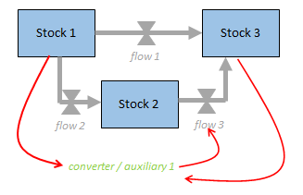
System Dynamics – Key Components
A system’s behavior is dictated by its structure.
Circular chains of cause-and-effect relationships drive (often non-linear) behavior. These feedback loops can either:
Accelerate change (Reinforcing feedback)
Counteract change (Balancing feedback)
Structure is made up of operational elements:
Where stuff accumulates (stocks)
What activities fill or drain those accumulations (flows)
What additional information impacts these activities (converters/auxiliaries)
How variables are inter-related to determine the magnitude of activities (connectors)
A system’s stock/flow structure and associated feedback mechanisms can be simulated in order to understand:
How it is likely to behave over time (in its current form)
How it might respond to:
Parameter changes
Policy initiatives/alternate decision rules/strategic decisions
Structural modifications

Slide 8
System Dynamics: Why…
Comparing Systems and Thinking Processes
While systems are… | …our thinking processes often…
Constantly changing | …are static, equilibrium oriented
Tightly coupled/interdependent | …draw very narrow boundaries around issues and problems
Rich in feedback | …treat drivers of performance as external and independent
Nonlinear | …assume linear responses
History dependent | …neglect to consider path dependence, accumulations, and delays
Adaptive and evolving | …fail to pay sufficient attention to the sources of unintended consequences
Adapted from Sterman, Am J Public Health, 96:3 (March 2006)

Slide 9

System Dynamics: Essential practices and tools
Characterizing the space
“...System dynamics emphasizes a multifaceted process for testing models, identifying errors, and comparing model assumptions and behavior to data. The process of model testing and improvement is iterative. Discrepancies between mental models, formal models, and data stimulate improvements in each”
--Am J Public Health. 2006; 96:505-514
Dynamic thinking—behavior over time
Operational thinking—stocks and flows, physical representation
Feedback thinking
A set of practices
Tools for modeling and simulation (Stella, Vensim, Powersim…)

Slide 10
Potential and Pitfalls
A challenge: Getting to something Useful under time constraints
Value/Utility
Complex model/interface
“Mother of all Models”
Simple model/interface
"Any intelligent fool can make things bigger and more complex. It takes a touch of genius and a lot of courage to move in the opposite direction."
—A. Einstein
Simple stock & flow map
“Conversational” use of thinking skills
Effort/Time Expended
(technical skills required)

Slide 11
Reference Behavior Patterns
A reference behavior pattern is a graph over time that captures the essence of a problem or issue of interest.
RBPs often contain a historical (“as is”) component as well as a projected (“to be”) component.
The unit of time (femtosecond, fortnight, year, etc.) for the RBP helps to set a temporal boundary for what to include in your analysis.
Examples:
Avg Engineer
Experience Level
Annual production of
Cellulosic Ethanol in the US
“To Be”
“As Is”
2007
years
months

Slide 12
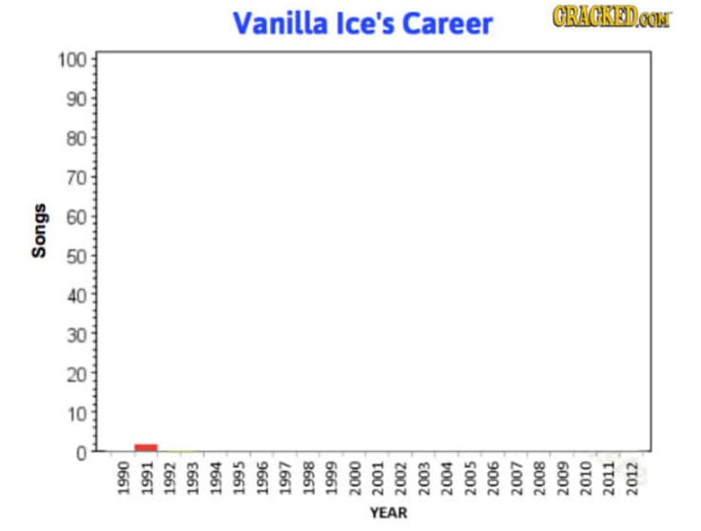
RBP Exercises
1. Sketch an RBP that relates to a phenomenon in your personal or professional experience. Be sure to provide appropriate labels for both the time axis and the vertical axis.
2. Steve Peterson is well known as a “coffee fiend” during the delivery of workshops. Create a RBP that might characterize the level of caffeine in his bloodstream over a 24 hour period, beginning at 6.00 AM.

Slide 13
Feedback Loops
A feedback loop exists whenever the current state of the system leads to activities which further change the state of the system.
Reinforcing loops
Amplify change
Run away from status quo
AKA positive feedback loops; AKA vicious/virtuous cycles
“Positive” doesn’t necessarily mean “good.”
Counteracting loops
De-Amplify change
Seek to maintain status quo
AKA negative feedback loops; AKA balancing feedback loops
“Negative” doesn’t necessarily mean “bad.”
State of System
(AKA “Condition”)
Actions

Slide 14
Creating Causal Loop Diagrams—An Illustration
In many metropolitan areas, traffic planners respond to lengthening commuting delays by constructing more highways….
…but shorter commute times increase the attractiveness of suburbs for commuters, thereby, facilitating housing and population growth. This in turn leads to an increase in traffic volume!
+
-
Commute
Time
+
(-)
Pressure to
reduce congestion
-
Highway
Capacity
Traffic Volume
+
Desired
Commute Time
+
Road
Construction
+
(-)
+
Attractiveness of
Suburbs for
Commuters
-
Population of
Suburban Commuters
+

Slide 15
Creating Causal Loop Diagrams—Guidelines
1. Think about the Dynamics.
key dynamic variable
“Homing in” behavior tends to be driven by negative feedback
Runaway growth/decline tends to be underwritten by positive feedback.
Start with the dynamic to be explained. Helpful to draw a graph of behavior over time. Helpful to describe the dynamic using a sentence or two.
Ask: What are the relationships that underlie the dynamic?
time
2. Map the loop(s)
3. Assign link and loop polarity
Ceteris paribus world
Use nouns and noun phrases
Avoid modifiers like more or less
Consider goals and gaps
Draw arrows from cause to effect
Close the loop(s)
Indicate delays with || in arc
Keep it simple.
Condition
Look at each link in isolation.
When change in cause causes effect to move in same direction, link is positive. Indicate with “ + ”
When change in cause causes effect to move in opposite direction, link is negative. Indicate with “ – ”
Walk around loop. Does initial change in one variable lead to further change in same or opposite direction when you trace around the loop?
Change in same direction → positive loop. Indicate with (+ or “R”) in center.
Change in opposite direction → negative loop. Indicate with (- or “C”) in center.
Condition
+
(+)
Reinforcing
Action
Reinforcing
Action
+
Condition
Goal or
Target
Goal or
Target
Condition
+
Corrective
Action
Corrective
Action
-
+
Gap
(-)
Gap
+

Slide 16
CLD Exercises – Label the Loops
Price
Inventory
Consumption
Production
Relative to
Consumption
Production

Slide 17
CLD Exercises – Label the Loops
investment
attractiveness
conversion
facilities
process
yield
through-
put
capital
cost
production
maturity

Slide 18
CLD Exercises
Draw one or more RBPs to show the behavior of key variables over time. Then map and characterize the feedback mechanism(s) described below as reinforcing or balancing loops.
1. Self-fulfilling prophecy
In response to news reports about falling supplies of gasoline at retailers, motorists went to gas stations in droves, further driving down supplies.

Slide 19
CLD Exercises
Draw one or more RBPs to show the behavior of key variables over time. Then map and characterize the feedback mechanism(s) described below as reinforcing or balancing loops.
2. Get the work done
At a local personal injury law firm (affectionately known as “Torts for the Masses”), the managing partners add to the size of their legal staff as case loads grow beyond desired levels.

Slide 20
CLD Exercises
Draw one or more RBPs to show the behavior of key variables over time. Then map and characterize the feedback mechanism(s) described below as reinforcing or balancing loops.
3. Is it getting hot in here or what?
For those who worry about global warming, the “albedo effect” can be a source of lost sleep. Here’s how it works: As snow or ice melts, a larger portion of the earth surface is exposed. Because of its lower albedo, the earth surface warms, accelerating the melting process.

Slide 21
CLD Exercises
Draw one or more RBPs to show the behavior of key variables over time. Then map and characterize the feedback mechanism(s) described below as reinforcing or balancing loops.
4. Econ 101
Economic theory teaches that price works to equilibrate supply and demand. When quantity supplied relative to quantity demanded is not in balance, price rises or falls, which in turn leads to an adjustment in quantity supplied and quantity demanded.

Slide 22
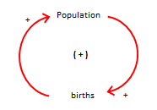
(Potentially) practical advice on CLDs
Knowing how to read and write CLDs is useful.
As with all approaches, CLDs have limitations.
Awareness of diminishing or negative returns is important.
High-productivity uses can include:
Brainstorming (individually or in a group)
Capturing notes or insights in a conversation or when reading
Explaining to someone else a simple feedback process that underwrites dynamics of interest

Slide 23
Types of SD Frameworks
Most SD facilitators ask participants to characterize the issue space with time-based behavior(s).
Behavior Over Time Graph (BOTG)
Reference Behavior Pattern (RBP)
Three (very) different approaches to represent system structure:
Archetypes
Causal Loop Diagrams (CLDs)
Stock/Flow Diagrams (SFDs)
Practitioners tend to stick with one approach (and undervalue the others)

Slide 24
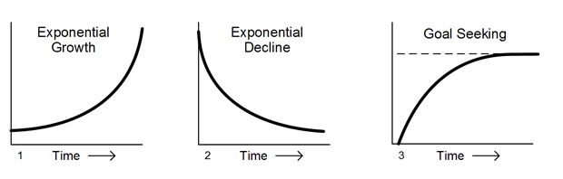
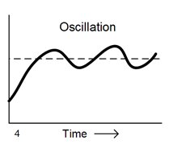
Archetype Behavior Focus
Does the historical behavior of key model variables match frequently observed patterns that result from common structures?
Pros
Gets audience thinking about behavior over time
Easy to establish corresponding structure
Cons
Behavior in question may not “map” to these archetypes
Oversimplification
Difficult to apply in situations with no historical data/analogs

Slide 25
Archetype Behavior Focus – System Archetypes
In The Fifth Discipline (1994), Peter Senge identifies several common situations featuring reinforcing and/or balancing loops.
When You’re Hot, You’re Hot
Eroding Goals
Escalation
Shifting the Burden to the Intervener
Tragedy of the Commons
Worse Before Better
Success to the Successful
Some SD practitioners of this approach try to first identify archetypes present in business/economic situations and then build a dynamic model from that evaluation.
Our experience suggests that this approach is sub-optimal.
“Force fitting” an archetype onto an unwarranted situation is common
Not all interesting dynamic problems have an archetype at their core
Archetypes may ignore important, operational stock/flow structure

Slide 26
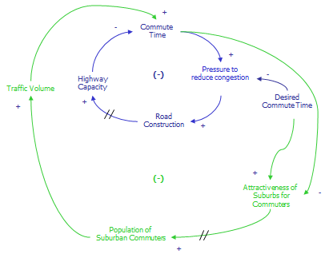
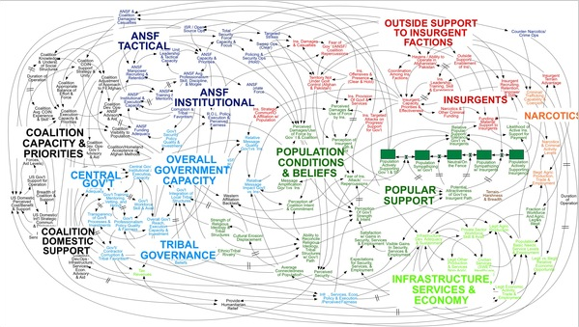

Causal Loop Diagram Focus
Can a high-level influence diagram capture the relationships in the system?
Pros
Gets audience thinking about dynamics, interactions and feedback
Easy to create, and extend
Participants leave session “feeling good”
Cons
Often wrong; sometimes stupid
Can get overly complex very quickly
Difficult to mentally simulate
Requires significant translation to produce a simulatable model.
“When we understand that slide, we’ll have won the war…”
--General Stanley McChrystal

Slide 27
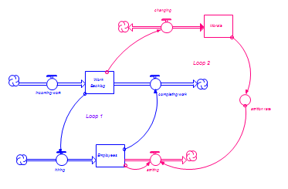
Stock/Flow Diagram Focus
What are the fundamental accumulations and associated flows in the system, and how are they connected via feedback?
Pros
Gets audience thinking operationally
Easy to create (whiteboard and/or computer)
Diagram matches resulting STELLA model
Can quickly be simulated (mentally and/or computer)
Cons
Requires the introduction of “building blocks”

Slide 28
SD Frameworks – Conclusion
In Lexidyne’s (decades’ worth of) experience, the stock/flow mapping process is the quickest and most effective way to:
Get at the “heart” of a dynamic problem = Operational Essence
Engage participants in an interactive mapping exercise
Facilitate communication between people of different functions in an organization
Create a model structure that builds consensus
Translate the results of a “white board” model-building exercise to a computer simulation
Build confidence that the resulting simulation isn’t:
Oversimplified
“Black Box”
A not-uncommon response: “This is the first time I’ve really understood this ‘systems stuff’.”

Slide 29
Thinking operationally
An example: What’s wrong with this picture?
Milk production = f(GDP, feed prices, interest rates, bond yields, … )

Slide 30
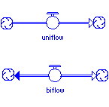
Identifying Stocks and Flows
Stocks: Nouns. Represent the current state, magnitude, or condition. Freeze action, and stocks persist. Accumulators. Balance sheet items.
Two fundamental stock types:
Reservoir: Most common form of stock. Think of it as a bathtub.
Conveyor: A “moving sidewalk.” Use it to represent a process at the highest possible level, or to represent a pipeline delay process.
Flows: Verbs. Represent actions/activities that fill or drain stocks. Freeze action, and flows disappear. Income statement items. Helpful to use “ing” endings.
Uniflow: Most common form of flow. Flows in one direction only.
Biflow: Flows in both directions. Use whenever the same process causes the stock to build or decline.
90%
10%
98%
2%

Slide 31
Simple Structure-Behavior Pairings: Exercises
The Mysteriously Expanding Body
A friend of mine (we’ll call him John because that’s his name) found himself gaining weight over the past several months. He didn’t like this at all, and engaged in two initiatives in response. First, he stopped his mid-morning and mid-afternoon trips to the pastry cart. Second, he began and sustained an aerobic exercise program.
After one month of engaging in these initiatives, John found that he had continue to gain weight! Use stocks and flows to think through how this might happen.
Note: There are no “tricks” here. For example, John didn’t compensate for his lack of pastry cart by eating more at regular meals. Nor does the solution have anything to do with the difference in density between muscle and fat.

Slide 32
Identifying Stocks and Flows
Stock/flow connections can …
…be very simple
…include multiple flows:
…be used to form “main chains”

Slide 33
Two Rules of Grammar
To take advantage of the power inherent in the language of stocks and flows, you must…
Respect Unit Consistency
and
Respect Conservation Laws

Slide 34
Two Rules of Grammar
Rule 1: Respect Unit Consistency
Each flow into or out of a stock must use the same units of measure as the stock itself, except for “per time.”
All stocks in a main chain must use the same units of measure.

Slide 35
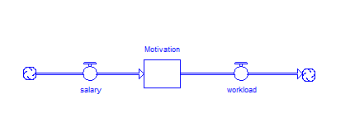
Two Rules of Grammar: Exercises
What’s wrong with each of these pictures? Think about the units of measure—is the stock and flow representation respecting unit consistency? Conduct a mental simulation of the map to help you assess the goodness of the representation.
1. “Pollutants are being dumped into our water supply.”
2. “Salary builds motivation but heavy workload depletes it.”

Slide 36
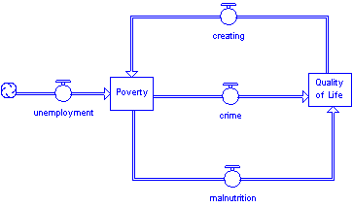
Two Rules of Grammar: Exercises
What’s wrong with each of these pictures? Think about the units of measure—is the stock and flow representation respecting unit consistency? Conduct a mental simulation of the map to help you assess the goodness of the representation.
3. “Unemployment affects poverty, which in turn causes crime and malnutrition, thus impacting quality of life which in turn creates even more poverty.”
crime
Poverty
Quality of Life
unemployment
malnutrition

Slide 37
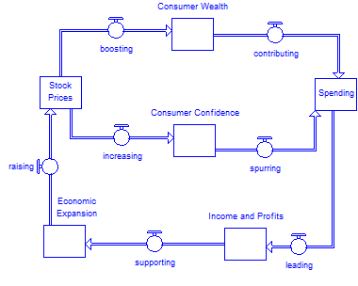
Two Rules of Grammar: Exercises
What’s wrong with each of these pictures? Think about the units of measure—is the stock and flow representation respecting unit consistency? Conduct a mental simulation of the map to help you assess the goodness of the representation.
4. “Higher stock prices will boost consumer wealth and increase confidence, which can also spur spending. Increased spending will lead to higher incomes and profits that, in a virtuous cycle, will further support economic expansion.” - Federal Research Chairman Ben Bernanke (in justifying the Fed’s 2010 purchase of long-term Treasury notes)
Consumer
Wealth
Stock
Prices
Consumer
Confidence
Economic
Expansion
Income and
Profits
Spending

Slide 38

Two Rules of Grammar
Rule 2: Respect Conservation Laws
In the physical world, all flows come from somewhere (depleting some feedstock) and go to somewhere (filling some repository).
In the non-physical world, virtually all flows come out of/vanish into thin air!
In building a model, you must make a conscious choice about conserving physical flows. It’s a decision about the model boundary.

Slide 39
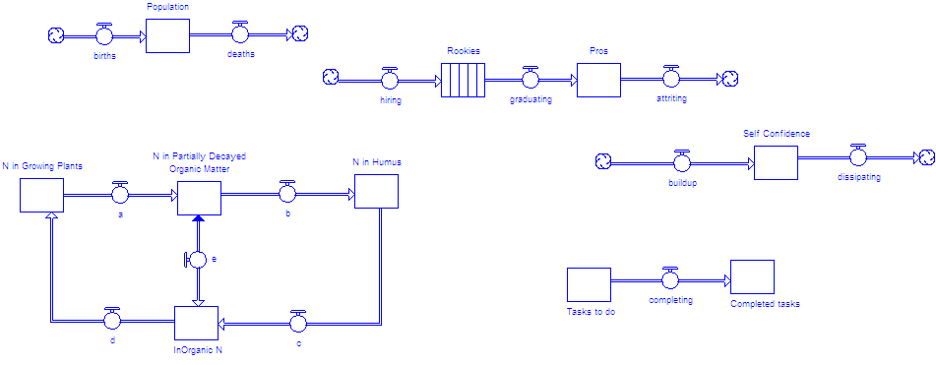
Telling only part of the story…
By themselves, stock and flow maps provide an important framework, but they tell only part of the story…
By generating flow activity it’s possible to develop a deeper understanding of connection between structure and performance…providing some leverage into changing the performance of the system.

Slide 40
The connector drives activity generation
Two ways to do it:
Use a connector to connect a Stock to the flow
Use a connector to connect a flow to the flow

Slide 41
Why care? Big differences in dynamics!
Wood for thought
Here are two representations of the process of building up muscle mass, associated with the splitting of wood. Mentally simulate each representation. Which representation is better? Why?
A.
B.
building
building
Muscle
Muscle
Mass
Mass
Wood in
Wood in
the Stack
the Stack
splitting
splitting

Slide 42
Why you need converters!
There’s a subtle but important issue with the maps we’ve seen thus far:
If you take a close look at the units of measure of the flow vs. its “driver,” you’ll see an inconsistency.
The converter is the language element that enables us to fix these problems.

Slide 43
Converters: Adverbs and productivity terms
They tell how quickly or slowly action is unfolded by the driver of a flow
In this role, you can think of converters as productivity terms. They tell how productive the stock or flow is, in generating a flow.

Slide 44
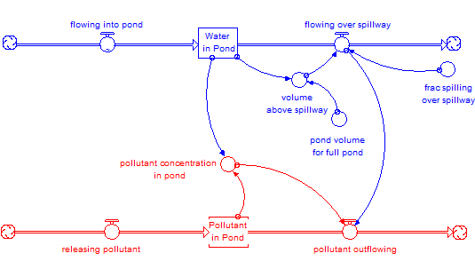
Aside: connectors and converters are also used to knit together model inputs and outputs

Slide 45
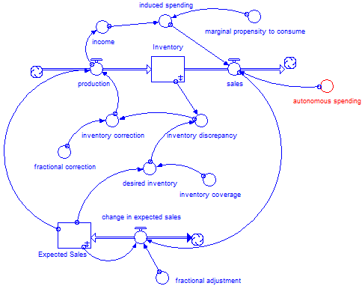
Aside: connectors and converters are also used to knit together model inputs and outputs

Slide 46
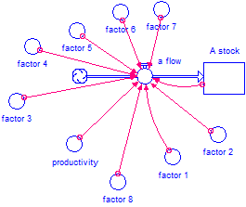
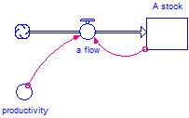
Representing flows simply: Generic Activity Templates
The stock-to-flow and flow-to-flow linkages are simple and effective ways to operationally specify flows in your maps and models.
It’s helpful to view these linkages as generic in nature. In our experience, five generic templates can form the basis for generating maybe 80 - 90% of the flows in your models.
Using these specifications (as opposed to ad-hoc approaches) can keep you in control of the modeling effort.
Good!
Icky!

Slide 47
Five Generic Activity Templates
External
Resource
Template
Co-Flow
Template
selling = Sales Reps * sales productivity
revenue = selling * price
Compounding Template
Draining Template
OR
acquiring = Customers * word of mouth multiplier
attriting = Employees * attrition fraction
attriting = Employees / avg duration of employment
Gap-
Adjustment
Template
OR
changing the condition = gap / time to adjust gap
changing the condition = gap * fractional rate of gap adjustment

Slide 48
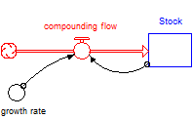
Generic Activity Templates: Compounding
Compounding Template Diagram
Eq’n for Flow
Compounding flow= stock * growth rate
Behavior of system in isolation
Use this template when the stock is doing the work of generating its own inflow.
Potential applications include
Population growth
Financial dynamics
Word-of-mouth
Viral phenomena

Slide 49
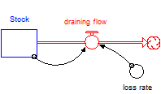
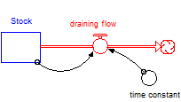
Generic Activity Templates: Draining
Draining Template
OR…
Eq’n for Flow
draining flow = Stock * loss rate
Or
draining flow = Stock / time constant
Losing 50% of your stuff each year is the same as saying on average, stuff sticks around for 2 years!
Behavior of system in isolation
Use this template when the stock is doing the work of generating its own outflow, or when you want to represent a passive decay process.
Potential applications include
Aging processes
Mortality, attrition, and other system losses
Radioactive decay

Slide 50
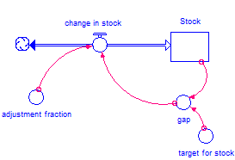
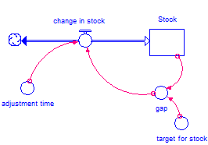
Generic Activity Templates: Stock-adjustment
Stock-Adustment Template
OR…
Eq’n for Flow
change in stock= gap * adjustment fraction OR change in stock = gap / adjustment time
Often used to represent perception processes (seeking some target or actual condition).
Also used to represent “goal seeking” physical processes
Potential applications include
Moving averages
Heat transfer (Newton’s law of cooling)
Hiring
Perceptions
Behavior of system in isolation

Slide 51
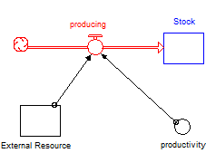
Generic Activity Templates: External Resource
External
Resource
Template
Behavior of system in isolation. Things get more interesting when there are flows attached to the eternal resource
Eq’n for Flow
Producing = External Resource * productivity
Use this template when some stock, but not the stock that is accumulating or de-cumulating this flow, is doing the work of generating the flow.
Potential applications involve producing stuff, in the most generic sense…
Widgets
Intellectual property
Sales

Slide 52
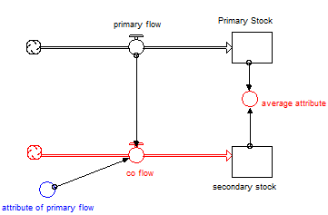
Generic Activity Templates: Co-flow
Co-Flow Template
Eq’n for co-flow and average attribute
co flow = primary flow* attribute of primary flow
average attribute = secondary stock/Primary Stock
Use this template when two flows move in concert, or when you want to keep track of attributes as stuff moves through a system
Potential applications include
Tracking pollutant concentrations
Connecting sales to revenue
Activity based costing
Corporate average fuel efficiency
Behavior of co-flow depends on what’s happening with the primary flow and productivity term.

Slide 53
Generic Activity Templates: Exercises
1. Bugs
The software engineers at the Rugged Macro software company have discovered that in the process of coding, they inadvertently introduce bugs into their software. Specify the processes of writing code and introducing bugs.
2. Greenhouse Gases
The greenhouse gas carbon dioxide is a natural by-product of any respiration activity. Whenever we breathe, we are emitting greenhouse gases! However most of the concern around the emission of greenhouse gases is not focused on people’s breathing processes. Rather, it is focused on the burning of fossil fuels. As fossil fuels are burned, for example in coal-fired power plants or in automobiles, greenhouse gases are necessarily emitted.
Use generic activity templates to generate the flow of emitting greenhouse gases. You may wish to consider two inflows to greenhouse gases—one generated by burning fossil fuels in power plants, the other generated by the burning of fossil fuels in cars.

Slide 54
Generic Activity Templates: Guidelines
Ask, “How does this process work?” DON’T ASK, “What are the factors that influence this flow?”
Then, work to match the nature of the process against one of the templates
Determine whether the flow is stock-generated vs. flow-generated.
If some external resource is doing the work, use the external resource template.
If the flow moves in concert with some other flow, use the co-flow.
If the stock is generating its own inflow, use the compounding template.
If the flow out of the stock is best characterized as a “passive decay,” use the draining template.
If there is some adjustment towards a goal or target, consider stock-adjustment
Use mental simulation to test your choice of flow specification.
Resist the temptation to have more than TWO wires into a flow.
Resist the temptation to use an ad hoc specification.
Don’t forget the productivity term.

Slide 55
Generic Activity Templates: In-class exercise
Use generic flow templates to specify each flow. Use the text below to help you select the appropriate templates.
Clients generate work; professionals complete it.
The firm gains new clients through word-of-mouth.
The firm loses a certain % of its clients each year.
Professional headcount is adjusted to a target headcount. Don’t concern yourself (yet) about how this target is set.
Professionals build skills by completing client work; their productivity in doing this work is primarily determined by their skill level.

Slide 56
Other roles for the converter
Low-cost stock substitute…
Container for flow logic…

Slide 57
Other roles for the converter
Alternate unit of measure for stock…
Roll-up of multiple stocks or flows…

Slide 58
Other roles for the converter
Repository for cheap algebra…
Housing for model inputs…

Slide 59

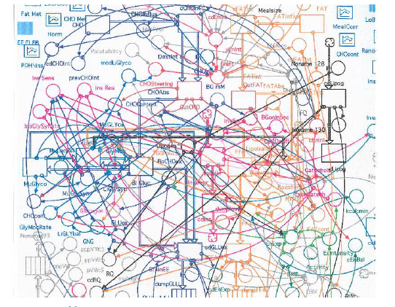
Model Extremes (from A to Z)
A
“Sweet Spot” = A simple (but not simplistic!) framework that provides insight into the structure/behavior of a complex, dynamic system.
Z

Slide 60
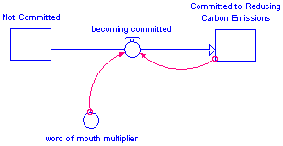
Feedback loops – Stock/Flow Framework
A feedback loop exists whenever the current state of the system leads to activities which further change the state of the system.
There’s a feedback loop in place whenever a stock is connected to a flow that changes the magnitude of the stock. The connection can be direct, or more tortuous.
changing
Morale
Loop 2
Work
incoming work
Backlog
completing work
Loop 1
attrition rate
Employees
hiring
attriting

Slide 61
System Dynamics Modeling Progression
Why are we building this model? Purpose Statement
What’s the behavior of the system over time? Reference Behavior Pattern(s)
What’s accumulating? Stocks
What’s filling/draining the accumulations? Flows
What simple, operational processes are driving the flows? Generic Activity Templates
What interconnections exist between model elements? Feedback Loops
How does the simulation respond to changing inputs/scenarios/policies? Model Testing
Reflect and Iterate!!!!

Slide 62
Potential and Pitfalls
One framework for thinking about model effectiveness
Protective Model | Reflective Model
Prove a point | Promote inquiry
Obscure assumptions | Expose hidden assumptions
“Cherry pick” data | Identify data weaknesses
“Prove” preconceptions and preselected answers, while covering biases | Challenge beliefs while support multiple perspectives and involving a broad community of interests
Promote the authority of the modeler | Promote the empowerment of clients
Adapted/revised from Sterman, 2000, from Isaacs and Senge, 1992

Slide 63
Potential and Pitfalls
High-Level schematics => good introduction to SD models
Biomass Scenario Model
Key
Outputs
“Downstream”
Feedstock
Supply
Feedstock
Logistics
Feedstock
Conversion
Distribution
Logistics
Dispensing
Stations
Fuel Use
Import
Inventory
and Pricing
Vehicle module
Regional VM x 10
External Data
and Scenarios
Petroleum Industry
Generate scenarios focusing on the evolution of supply chain for biofuels
Material flow (e.g., Feedstock, fuel)
Information flow (e.g., relative fuel price)

Slide 64
A Brief Bibliography
Resource | Author/Publisher | Notes
Business Dynamics | John Sterman, Wiley (2000) | Encyclopedic coverage. Great reference book. Primarily business focused.
Competitive Strategy Dynamics | Kim Warren, Wiley (2002) | Stock and flow perspective applied to strategy. Clear and accessible.
Modeling the Environment | Andrew Ford, Island Press (1999) | Accessible treatment of how to apply dynamic modeling to environmental issues and problems
The Fifth Discipline | Peter Senge, Doubleday (1994) | Qualitative treatment of broad array of dynamic modeling skills and topics. Popularized “systems thinking” approach. Many follow-on “field books” published over the years.
Modeling Dynamic Biological Systems | Bruce Hannon, Matthias Ruth Springer-Verlag (1999) | Good reference book. Uses iThink/STELLA models. Note that Bruce Hannon has co-written several other books on dynamic modeling published by Springer
Feedback Thought in Social Science and Systems Theory | George Richardson, Pegasus Communications (1999) | Scholarly. Traces development of feedback concept from ancient times to the present.
The Systems Thinker Newsletter | Pegasus Communications www.pegasuscom.com | Newsletter format. Pegasus website is a clearinghouse for a host of dynamic modeling/system dynamics/systems thinking resources.
Modeling Dynamic Systems: Lessons for a First Course | Diana Fisher, iseesystems (2005) | Nice introductory treatment
Industrial Dynamics | Jay Forrester, Pegasus Communications, (1961) | Classic book on system dynamics, written by the founder of the field.
Introduction to Systems Thinking | Barry Richmond, iseesystems (2002) | Extremely accessible work produced by one of the leading lights of the field.
Tracing Connections: Voices of Systems Thinkers | isee systems/The Creative Learning Exchange (2010) | Real-world examples from multiple practitioners. Wide variety of contexts. A good read.

Slide 65
STELLA Specifics
Software Details

Slide 66
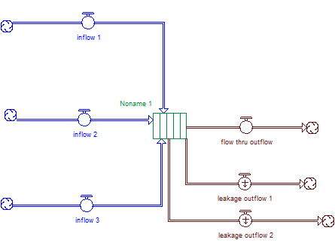
Conveyor: A special kind of stock
Conveyor Inflows
Multiple inflows to Conveyor allowed
Flows can come from clouds (shown here) or from other stocks
Conveyor Outflows
Multiple outflows allowed
First outflow you draw = “flow-thru” flow. Flow-thru captures whatever does not leak as it moves through the conveyor
Second and subsequent outflows are designated as “leakage” flows. Can specify fraction of what gets on the conveyor that leaks out through leakage flow. Can specify portion of conveyor that is prone to leakage
Conveyor
Stuff has to be “pulled out of” a reservoir.
Stuff is “pushed through” a conveyor!

Slide 67
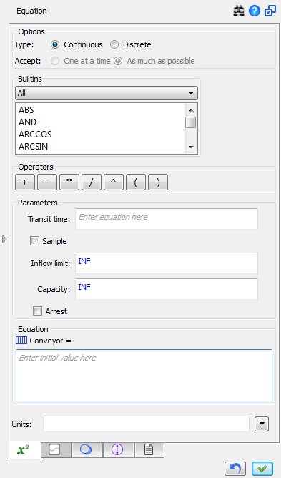
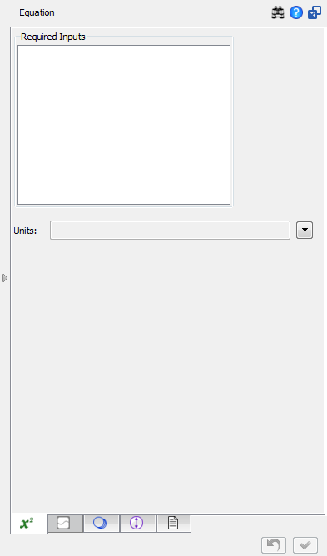
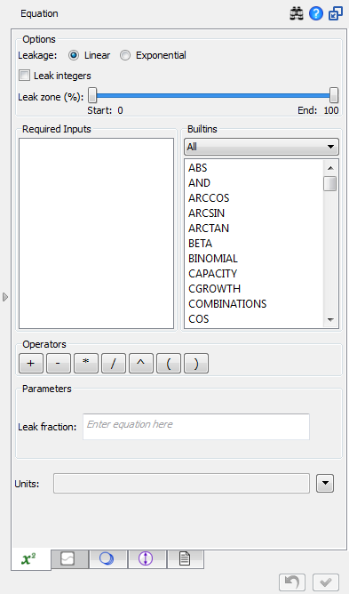
Conveyor: A special kind of stock
Conveyor Flow-thru
Nothing to define here under most circumstances. Transit time is handled in conveyor dialog; Leakage captured by leakage dialog. Whatever makes it to the end goes through this flow.
Conveyor Leakage
Set beginning and end of no leak zone.
Conveyor
Define variable or constant transit time. Drag and drop a variable to put variable transit time box into the dock.
Possible to specify constant capacity and/or inflow limit.
Inflow limit acts as bottleneck at entrance to conveyor, constraining inflows to not exceed specified volume per unit time
Capacity automatically constrains conveyor inflows to prevent total “weight” of conveyor from exceeding specified value
Define initial value for conveyor in the equation box.
Use required inputs, builtins, or constant to define leak fraction

Slide 68
Guidelines for Using Conveyors
Consider using a Conveyor when…
You want to capture the dynamics of a “pipeline delay”
You want to capture a process (such as a development process) at the highest possible level
Your major concern is the amount of time that material spends “in process”
It’s important to maintain “arrival integrity”
You’re modeling a discrete (vs continuous) process
Consider using a Reservoir when…
You need explicit control over the outflows from the process
Material in the stock can be appropriately handled as a “mixed” quantity
There are many outflows from the stock (4+)
You want to represent the physics of the flows (as opposed to just “time in process”)

Slide 69
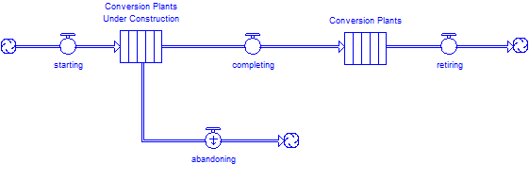
Conveyor Example
Industries relying on heavy capital investment often experience significant lags based on construction delays. An empty construction pipeline today can mean lack of capacity tomorrow! Below is simple stock-flow diagram depicting the capacity pipeline for a new generation of biofuels conversion plants.

Slide 70
Using Unit Checking in Stella: Context
Dimensional analysis is simple yet powerful way to increase the rigor of your thinking.
If units on left hand and right hand side of equation resolve to the same thing, your equation passes a first level of plausible
If LHS and RHS are inconsistent, you’ve got problems
Bad theory?
Stupid equation?
Silly mistake (adding when you should have been multiplying)
ALWAYS a good idea to do a mental unit check on each eq’n before you hit OK
Stella has built-in checking capability that can (and will!) catch errors in your mental check

Slide 71
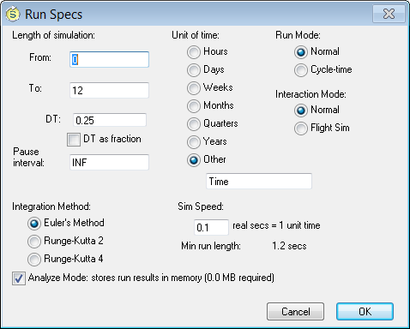
Using Unit Checking in Stella : Basic Approach
Set the base unit of time.
Enter Run Specs
The unit you choose will be applied to flows in your model.

Slide 72
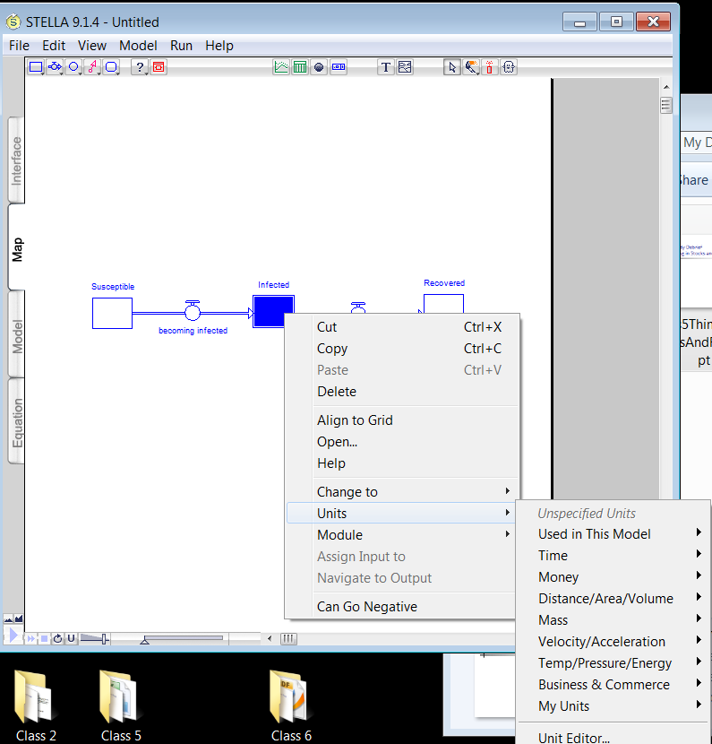
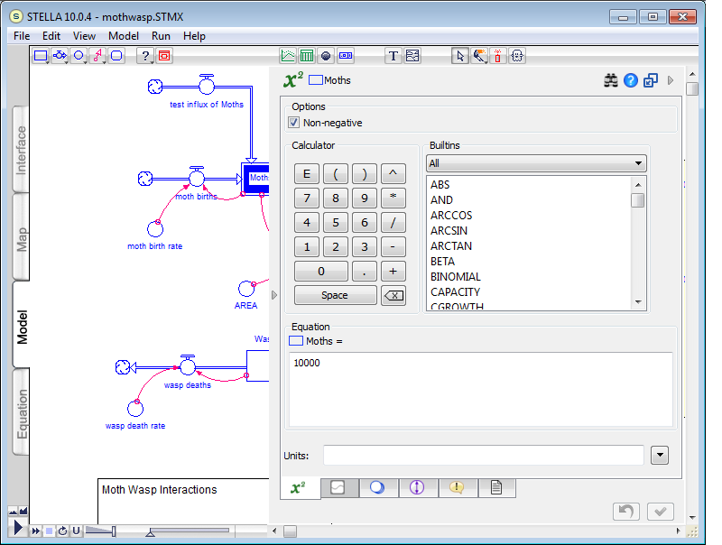
Using Unit Checking in Stella : Basic Approach
Apply units to stocks
Select a stock
Right click on stock, or enter its eq’n space and click the units drop-down at the bottom of the space.
Pick a unit from the list of default units, or enter the unit editor and define your own. Note that units are grouped (“people” lives in business & commerce. So does “unitless”)
The unit you select or define will be applied to all stocks in the main chain. Unit-per-time will be applied to all flows in the main chain

Slide 73
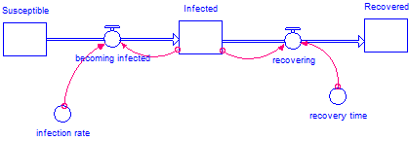
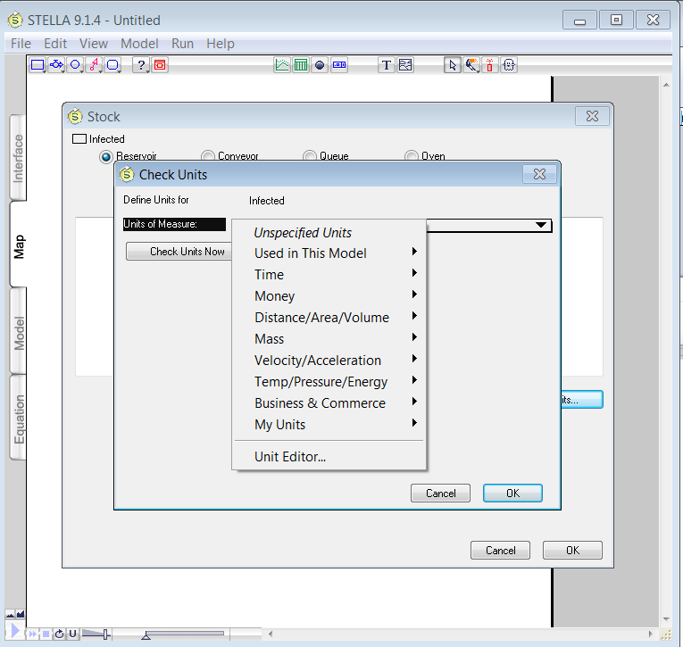
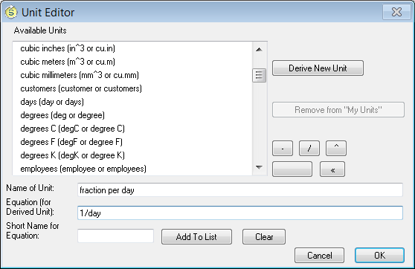
Using Unit Checking in Stella : Basic Approach
Apply units to converters
Select converter. Right click, or enter enter units through its dialog
Pick a unit from the list, or derive a unit using the unit editor (shown below)
Add the new unit to the list and/or OK your way out of the dialog
Type this
Use list to click in eq’n for unit

Slide 74
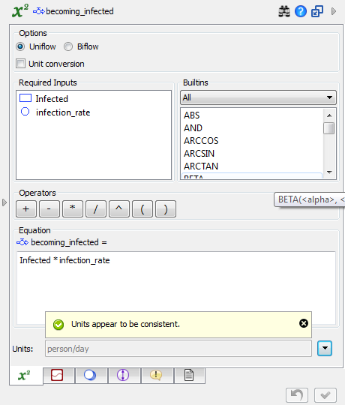
Using Unit Checking in Stella : Basic Approach
Check for unit consistency
Method 1: Check entire model : Run Menu→Check Units. Useful to double check after model is completed
Method 2: Check as you go. From within dialog, click on the drop-down next to the units field. You’ll get an alert if you have problems.

Slide 75
Hints and Tips:
In defining units , you have limited algebraic options
NOT OK: widgets/person/week
OK: widgets/person-week
Some built-ins will choke on units (e.g., Ramp)
Run → check units fails to correctly check units for conveyor transit time
Good to keep names of units short/terse.
Lexidyne (prompted by Steve!) often uses CamelCase to define units (less ambiguity around spaces).

Slide 76
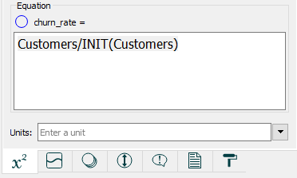
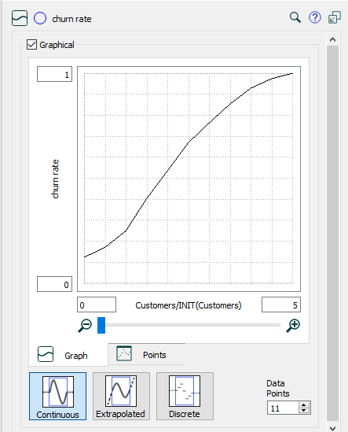
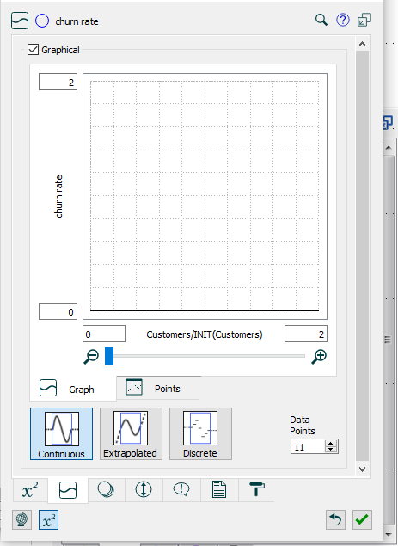
Creating graphical functions
Simple way to represent nonlinear relationships
You can use graphical functions to represent input-output relationships as a lookup table or as a picture. Graphical functions can also be used to represent time-dependent input scenarios.
Begin by drawing connector(s) to represent the interdependency relationship(s)
Open the converter (here, “churn rate”) and define the input to the graphical function. Often helpful to “normalize” the input as shown here.
Click the graphical function tab, and then check the box in the graphical function panel
Create the graphical function
Think only of the relationship between the input and the output variable, holding constant all other variables that might impact the output variable (Ceteris Paribus Principle).
Define ranges for the input and output variables. Be sure to define a range that incorporates the full possible movement, not just the historically-observed range.
Determine the direction of slope; the slope should, in almost all cases, be either positive or negative (or zero) over the whole range. If the slope changes direction, be certain you are not inadvertently including another influence in your thinking.
Identify extreme points on either end of the range (possible to extrapolate beyond extrema). In some cases, you’ll also be able to identify a so-called “normal” points.
Sketch a smooth curve through the points.
Also possible to create a graphical function by typing or pasting points directly
25%/mo churn under “normal” conditions

Slide 77
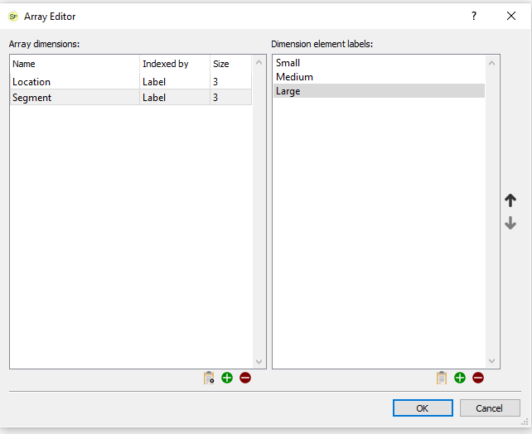
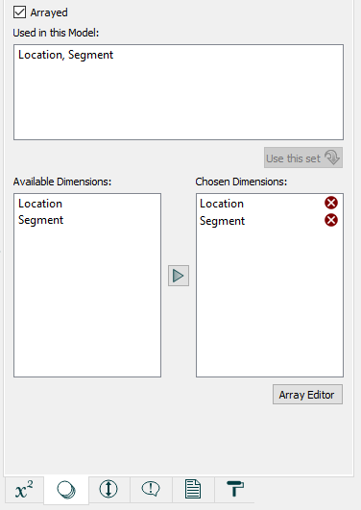
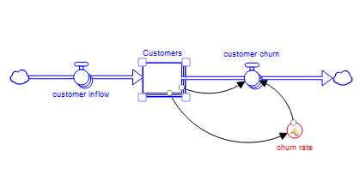
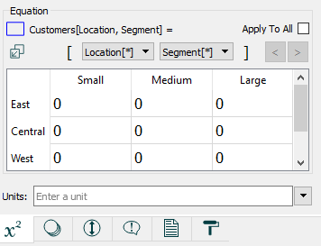
Working with arrayed variables
Model Segmentation and disaggregation
Arrays are helpful whenever a common model structure is repeated in parallel multiple times. Copy/paste can become very unwieldy!
The software supports n-dimensional arrays. (4-D arrays represent an upper limit in most practical applications.)
Steps to using arrays:
Use the array editor (model menu→ array editor) to define one or more dimensions
Transform scalar variables into arrayed variables. When you change a stock, attached flows will change as well.
Define the equation logic for arrayed variables
See Help system (Building models → working with arrays section) for more than you’d ever want to know!
Can use element-specific eq’ns (shown here) or a generic eq’n that is applied to all

Slide 78
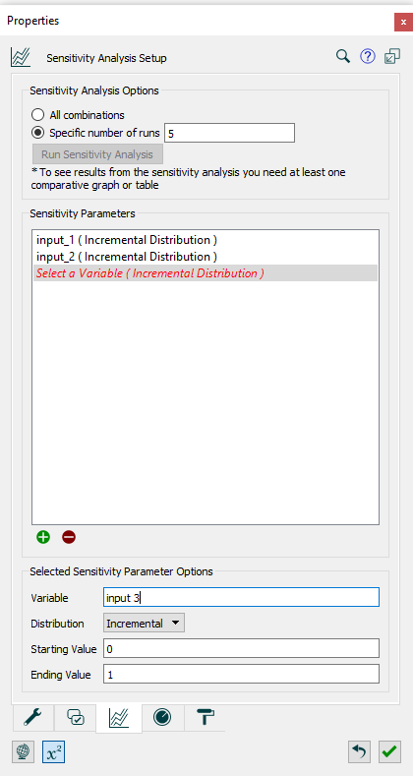

Sensitivity Analysis
For exploration of parameter space
Useful for understanding responsiveness of system to changes in one or more parameters. Provides mechanism for exploring risks and uncertainties.
Steps to working with sensi analysis:
Enter the setup dialog(model menu→ Run specs → tab)
Hit the green button and then load each sensi input to the parameters list. Can set variation type as incremental, as a distribution, or as ad-hoc sequence of numbers
Set up the analysis to reflect all combinations or a specific number of runs
Hit the check box to confirm your setup
Create one or more comparative graphs/tables to collect results.
Run the analysis
See Help system (Running models → Sensitivity analysis section) for more than you’d ever want to know!

Slide 79
Case Studies
October 2019
capstone, new product diffusion, predator/prey

Slide 80
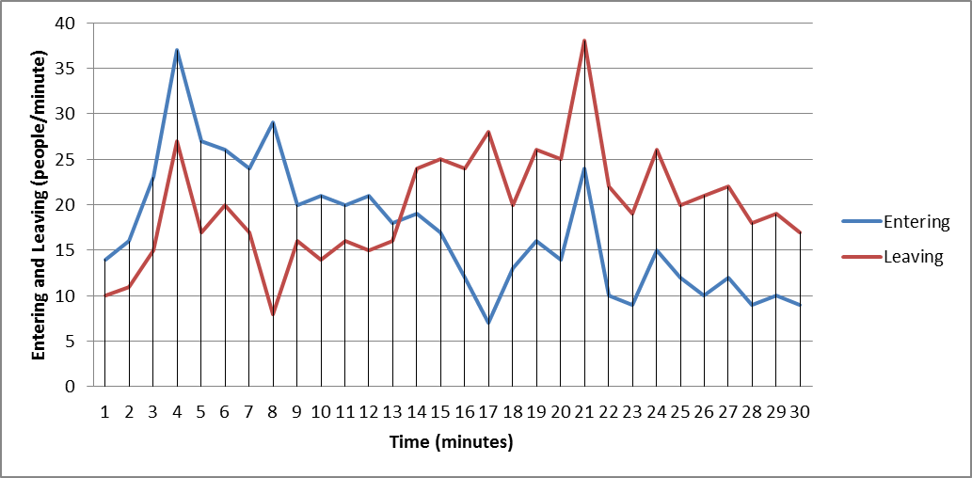
SD Case Study 1
Consider this Data from NREL Security Desk
When are most entering?
When are most leaving?
When are most in building?
When are fewest in building?

Slide 81
SD Case Study 2
Work by yourself to think through this scenario:
How it’s put together:
A service organization has two classifications for its professional staff, Rookies and Pros, based on experience levels. When Pros leave the organization, Rookies are immediately hired in exact number to replace them. After being hired, Rookies immediately enter an intensive 6-month training program. They emerge as full-fledged Pros after 6 months. The program is so good that no Rookies drop out or quit along the way. All Rookies are able to “graduate” to become Pros in exactly 6 months! Because of its position and reputation, the organization never has difficulty in its recruiting efforts. No matter how many Pros leave the firm in a given month, it is able to instantly hire that number of replacements in the form of high-quality Rookies.
This organization has been operating in a balanced headcount situation for several years. Hiring of Rookies has been constant, exactly equal to the loss of Pros from the organization (which also has remained constant for years). Now, all of a sudden (and for reasons that we’re not concerned about right now), the rate at which Pros are exiting steps up to a new, higher constant number of people per month. It then remains at this new value forever.
A question about the dynamics:
If the organization continues with its current hiring policy (i.e., immediately replace departing Pros by hiring Rookies), and the external environment continues to enable the organization to execute this hiring policy, what pattern over time will be traced by the number of Pros following the step-increase in the Pro quitting rate? Sketch your guess on the axis provided on the next page, or on a blank sheet of paper.

Slide 82
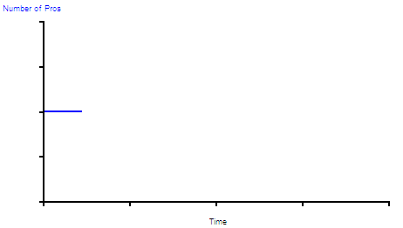
SD Case Study 2

Slide 83
Generic Activity Templates Exercise - A
In today’s data-rich environment, modeling projects often begin by taking a look “at the numbers.” Suppose you want to model the dynamics of the HIV/AIDS epidemic in the US. A quick Internet search has revealed the following data:
Use a basic stock/flow map to describe this system.
Questions to consider:
What is accumulating? What’s flowing?
What is the simplest possible representation of the operational nature of this dynamic?

Slide 84
Generic Activity Templates Exercise - B
With the “main chain” map laid out, now specify the flows using GATs.
Question to consider:
How does your representation compare to the basic GAT templates?

Slide 85
Generic Activity Templates Exercise - C
Treatment for HIV/AIDS patients is extremely expensive, averaging about $20,000 per diagnosed patient per year in 1994. Expand your model to include both the yearly and cumulative cost of treatment.
Question to consider:
What if average annual cost of treatment is not static, but instead increases at 6% per year?

Slide 86
Generic Activity Templates Exercise - D
The AIDS Quilt Project was designed to commemorate and honor lives lost to this disease. In 1994 there were approximately 10,000 “panels” on this enormous quilt. If 50% of HIV/AIDS deaths result in a new panel being added, how large (in terms of panels) has the quilt become?
Questions to consider:
What is the units of measure of the AIDS Quilt?
How might you calculate the size of the quilt in other units (square feet, pounds, etc.)?

Slide 87
Generic Activity Templates Exercise - E
The introduction of powerful new treatment “cocktails” in the mid-1990s significantly altered the dynamics of HIV/AIDS epidemiology. Specifically, mortality rates plunged. Suppose that beginning in 1994, the death rate for patients treated with these novel regimens was expected to fall by 5% per year.
Questions to consider:
What is the RBP for the mortality rate variable?

Slide 88
Capstone Exercise 1
You are planning to go on-line with a subscription-based internet service. This service aims to be a cutting-edge information and resource portal for pharmaceuticals researchers. Several people have told you that the key to your success involves attracting and retaining a sufficient number of subscribers to enable you to sustain profitability. Hard to argue with that!
a) Develop the simplest possible stock/flow map around subscribers
Consider the pool of subscribers for your service
Consider the activity of gaining subscribers
Consider the activity of losing subscribers
Sketch your map in the space below. Then, we’ll work as a group to implement the map in the software.
Questions to consider:
What assumptions are you making about the total potential amount number of subscribers in this system?
If you replaced clouds with stocks, what would those stocks be?
What other stocks are in this system?

Slide 89
Capstone Exercise 1
b) Transform the map into a running simulation model, using the following information.
Initially you have 2 subscribers
Assume you gain subscribers at a rate of 5 per month
Assume you lose subscribers at a rate of 1 per month
c) Set up a graph to collect model results for subscriber dynamics. Test.
d) Create sliders to control the flows. We’ll then do some simple tests.
e) Enter the Run specs… dialog under the Run menu. There, we’ll make a few changes.

Slide 90
Capstone Exercise 2
We’ll extend the model to more accurately capture the connection between subscribers and cash flow….
a) Modify the model so that it incorporates basic cash-flow dynamics.
Cash accumulates revenue net of expenses.
You plan to charge each of your subscribers a subscription fee of $50/subscriber/month.
There are two sources of expenses: Fixed expenses and variable expenses
Fixed expenses are $1000/month
Variable expenses are $25/subscriber/month
You’ve been seeded with $5,000 in start-up cash.
Monthly profit/loss is simply the algebraic difference between total revenue and total spending.
b) Using values of 5 for gaining subscribers, and 1 for losing subscribers, conduct a simulation. How close do you come to running out of cash over a 12 month period? What’s the maximum profit? Loss?
c) Explore different values for gaining and losing subscribers. Can you make yourself profitable “out of the gate?”
d) Explore different values for subscription fee. Implications?
e) Set up navigation buttons to move from the model to the interface view. Use text boxes to give your model a title.

Slide 91
Capstone Exercise 3
Colleagues have pointed out to you that internet-based businesses such as the one you are contemplating tend to grow via word of mouth. They also have noted that membership losses tend to be proportional to the size of the population. Let’s incorporate these concepts. Working from the Model view…
a) Add feedback from the stock of subscribers to its inflow.
Draw a connector from subscribers to its inflow. Note that a ? appears in the flow equation.
Re-define the inflow as a compounding process. Use a converter to represent the growth rate resulting from word of mouth. Your best estimate is that each 4 existing subscribers will generate one new subscriber each month.
On the interface level, use the dynamite to blow up the slider that you had assigned to the gaining flow.
b) Add feedback from the stock of subscribers to its outflow.
Draw a connector from subscribers to its outflow. Note that a ? appears in the flow equation.
Re-define the outflow as a draining process. Use a converter to represent the churn rate associated with the loss of customers. Your best estimate is you’ll lose customers at a rate of 10% per year.
On the interface level, use the dynamite to blow up the slider that you had assigned to the losing flow.
c) Run a simulation or two (you may find it helpful to set up a Run button to facilitate your experiments). What does the growth potential look like for this business? What sort of seed $ will you realistically need in order to capture this potential?

Slide 92
Capstone Exercise 4
Take a close look at the subscriber sector of your model. One difficulty with this structure is that it assumes an infinite number of potential subscribers. A second potential problem is that it doesn’t track drop-outs. Let’s fix these problems!
a) Add potential subscribers to the system.
Create a new stock. Call it Potential Subscribers.
Connect the stock to the inflow to subscribers, by dragging it over the cloud until the cloud is hi-lighted. Then release your click.
Initialize the stock of potential subscribers at 200
b) Add drop-outs to the system.
Create a new stock. Call it Drop Outs
Connect the stock to the outflow from subscribers, by dragging it over the cloud until the cloud is hi-lighted. Then release your click.
Initialize the stock at 0
c) Test your model. Do you see any “strange” behavior in the stocks?

Slide 93
Capstone Exercise 5
In your tests of the previous model, you likely found that the model “slammed against the wall” when it ran out of potential subscribers. This is because you’re missing a feedback loop here. We’ll fix this, now!
a) Add two converters to the screen. Call one, “base wom multiplier.” Call the second, “impact of potential subscribers on wom.” [note that wom stands for word of mouth!]
b) Draw connectors…
from the stock of potential customers to the impact variable
From the impact variable to your word of mouth multiplier
From base wom multiplier to your word of mouth multiplier
c) Re-define the three variables, using the next two pages for guidance.
d) Test your model. Does it perform more reasonably?.
e) Explore the response to changes in the word of mouth multiplier relationship. You may find it helpful to use a graphical input device on the interface layer to accomplish this.
f) Question to consider: Let’s say that you wanted to experiment with different “baseline” rates for those flows with feedback. How might you accomplish this?
g) Question to consider: Are there any strategies suggested by the stock of “drop-outs?”

Slide 94
Exercise 1 – New Product Introductions
Case Study: Since their release in 1997, digital video disk (DVD) players have had a very rapid adoption by US households. Data from the Digital Entertainment Group shows that these devices now exist in 75% of US households.
Sales for hot technology products such as DVDs are often driven by strong word of mouth, as excited enthusiasts tell their friends about the latest new gadget. You have been asked to analyze the uptake of DVD players to understand how big of an impact such word of mouth dynamics played, and how much was driven by the marketing efforts of various DVD manufacturers.

Slide 95
Exercise 1 – New Product Introductions
A Google search for “product diffusion” has brought up a list of references to something called the Bass Diffusion Model. Further investigation reveals this to be a well-established approach in the area of economic research. The model reads as follows:
q_{t} = p*R_{t} + w*N_{t}* (R_{t}/(R_{t} + N_{t} ))
where
q_{t} = number of adopters at time t
R_{t} = total number of potential adopters who have not yet adopted at time t
N_{t} = cumulative number of adopters at time t
w = effect of each adopter on each remaining potential adopter
p = effect of external factors (such as marketing) on adoption propensity
Clear as mud, huh?
In fact, this somewhat “inaccessible” formula can often be converted into a simple SD framework for the purposes of analysis and extension.

Slide 96
Exercise 1 – New Product Introductions
Let’s take this equation and see if we can identify any stocks and flows in it. Think about what’s accumulating and what activities fill/drain those “buckets.”
q_{t} = p*R_{t} + w*N_{t}* (R_{t}/(R_{t} + N_{t} ))
where
q_{t} = number of adopters at time t
R_{t} = total number of potential adopters who have not yet adopted at time t
N_{t} = cumulative number of adopters at time t
w = effect of each adopter on each remaining potential adopter
p = effect of external factors (such as marketing) on adoption propensity

Slide 97
Exercise 1 – New Product Introductions
That’s more like it!
Now let’s if we can plug in some values that would allow us to replicate the historical behavior of the DVD player market.
Assume that:
Research indicates that penetration is basically maxed out. (For simplicity, let’s ignore the growth in the number of US households and instead keep the model in % terms.)
Marketing efforts throughout the past 10 years have been relatively constant in dollar terms. Your colleague, an expert in the effect of advertising, has indicated that such spending levels typical result in an external coefficient (variable p) of about 0.008.
Further research shows that values for internal coefficients (variable w) are never more than 1.0.
DVD players were launched in 1997, and the data for the adoption of this product relates to end of year (EOY) numbers.
Using the STELLA software, create the structure for a Bass Diffusion model and experiment with different parameters of w. Can you find a value of w such that the simulation results closely approximate the historical data?

Slide 98
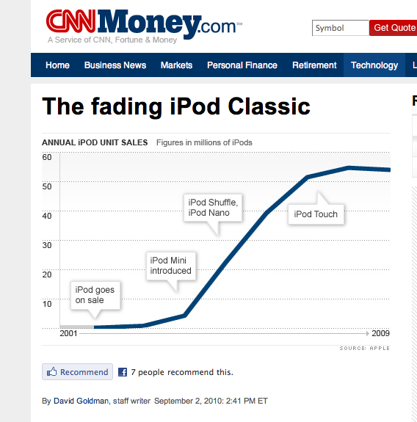
Exercise 1 – New Product Introductions
Wrap Up
Product/service diffusion curves often display behavior that can be characterized using the Bass formulation.
Consider the actual iPod data shown here and how such a dynamic could be modeled.

Slide 99
Exercise 2 – Feedback and Modules
Case Study: The Colorado Parks and Wildlife (CPW) division has asked you to build a model of deer and cougar populations in the Routt National Forest to assess the impact of allowing hunting in this region. The CPW is interested in the natural predator/prey dynamics of the area, as well as having a tool to assess possible outcomes given different intervention strategies. A Google search has produced an incomplete model (circa 1984 by Newes and Inman) that might serve as a starting point for the project. Open the model called Predator Prey.stmx.
As a good dynamic modeler, walk through the following steps:
Understand the existing model structure.
Eliminate the “?s” by finalizing undefined model variables.
Analytic initialization for the starting population of Deer
Parameter values for constants that will result in Steady-State
Run a simulation.
Question the validity of model structure. Are there places where feedback exists?
Close feedback loops, one at a time using graphical functions, retaining Steady-State.
Change an initial condition, then see the results of a subsequent simulation.
Assess reasonability of the outputs. What is causing the simulation behavior?

Slide 100
Exercise 2 – Feedback and Modules
Conversations with officials from the Forest Service indicate that the deer population also affects (and is affected by) the natural resources in the region; specifically, the amount of vegetation available. A web search reveals an un-copyrighted model by Peck (2018) that relates to the dynamics of vegetation.
Use a Module to import the model called Vegetation.stmx.
Establish links between the main Predatory Prey model and the Vegetation model residing in the Module.
Re-establish a Steady-State condition for the linked models/Modules.
Close any remaining feedback loops using graphical functions.
Extend the model by including a Hunter Module and assessing its impact on the system.

